Slide 1

Advanced Problems in Functions and Calculus A Practice Set

Slide 2
Welcome & Objectives

Slide 3
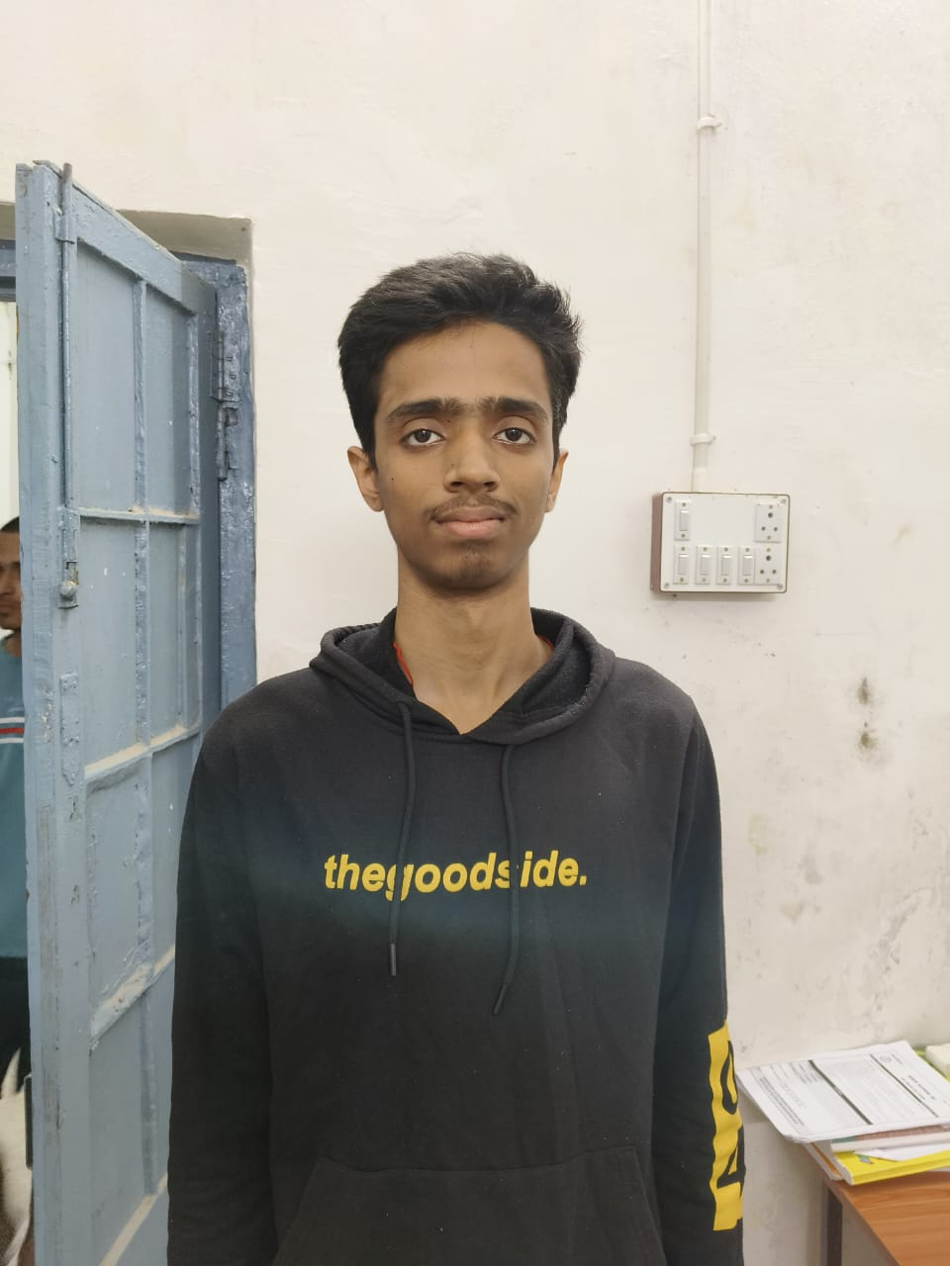
Question 1

Slide 4
Solution for Question 1

Slide 5
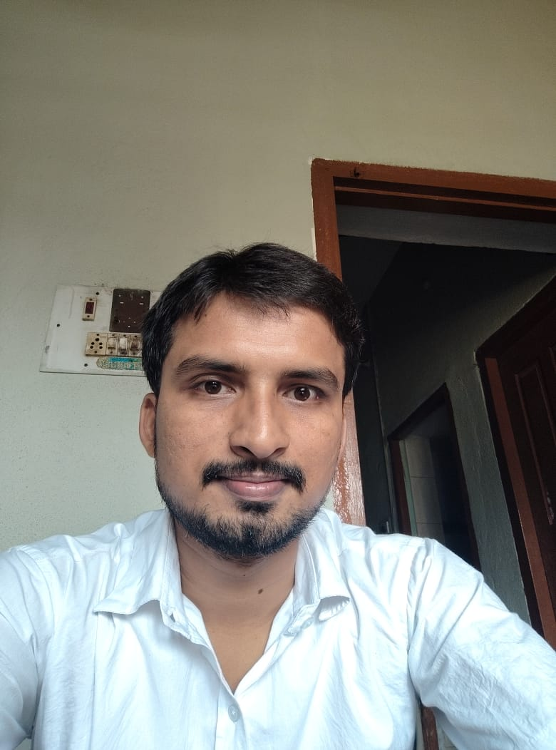
Question 2

Slide 6
Solution for Question 2

Slide 7
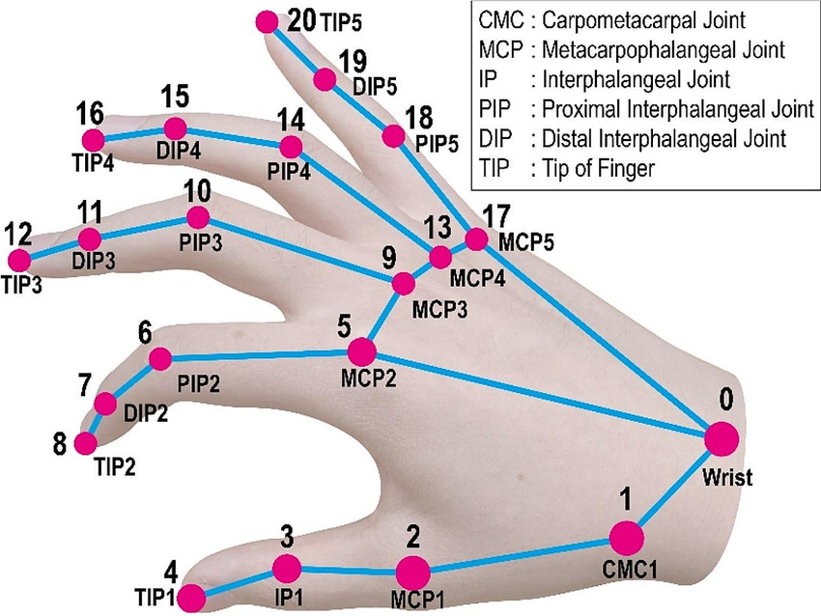
Question 3

Slide 8
Solution for Question 3

Slide 9

Question 4

Slide 10
Solution for Question 4

Slide 11

Question 5

Slide 12
Solution for Question 5

Slide 13
Thank You & Q/A

